Slide 1
Whose planet?
What do you think about these images?

Slide 2
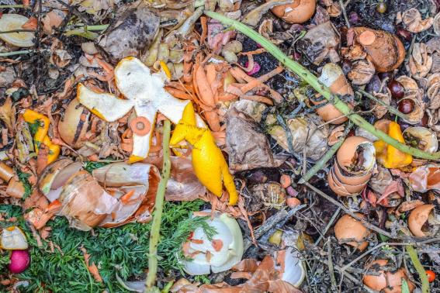
Yucky food waste or yummy dinner for worms and woodlice?

Slide 3
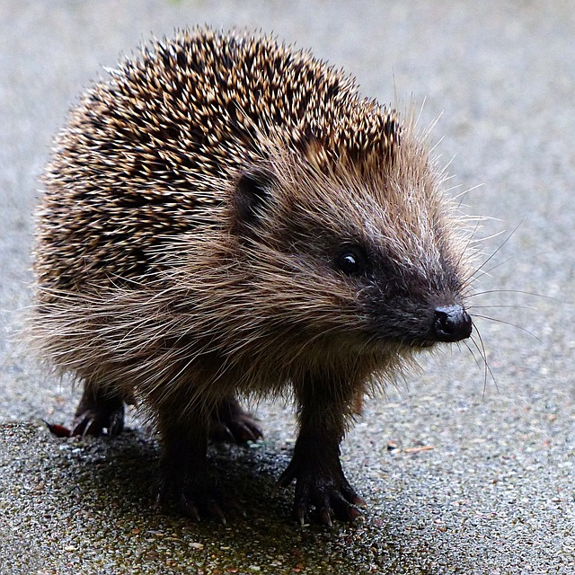
Is the hedgehog crossing the road or is the road crossing the hedgehog’s habitat?

Slide 4
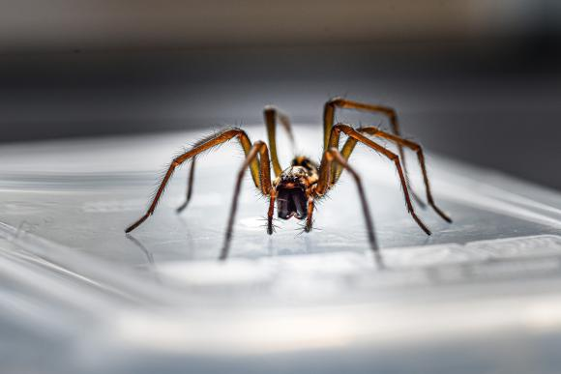
Do we help the spider find somewhere safe or do move so we are not disturbing the spider?

